Slide 1
Glen Park Association
Useful bits of SF history on the Internet
Notes:
My name is Jeremy Anderson and I am here to talk to you about a few things that I find fun and that I hop you will to. I want to show you some of the sites that are available online to you.

Slide 2
What is this about anyways?
Finding out “stuff” on your house.
Historical Research on your neighborhood
Maps
Photography.

Slide 3
San Francisco Property Information Map
Notes:
Really, the best place to start if you are looking for any information on your (or your neighbors) property is the easy to user SF property map. This site is awesome.
http://www.sf-planning.org/index.aspx?page=2719&recordid=23
The San Francisco Planning Department's innovative, user-friendly property information tool provides a single access point for a variety of useful property data, zoning and project information.
• Property Information (including Assessor's Reports, various Maps) • Property Zoning Information (including Zoning Districts, other Applicable Regulations) • Property Historic Preservation Data & District • Project History of the Property • Building Permit & Other Permit History of the Property • Complaint Record of the Property

Slide 4
DPW Key Maps
Dedicated
Grade
Monument
Notes:
http://bsm.sfdpw.org/subdivision/keymap/
Dedicated Maps
Grande Maps
Monument Maps
Don’t forget the 3% Grade issue for Curbing your wheels

Slide 5
Sanborn Fire Insurance
Maps from 1905
Notes:
The Sanborn Maps were originally created for assessing fire insurance liability in urbanized areas in the United States. The maps include detailed information regarding town and building information in approximately 12,000 U.S. towns and cities from 1867 to 2007. Author Kim Keister describes the legacy of Sanborn maps: "Stated simply, the Sanborn maps survive as a guide to American urbanization that is unrivaled by other cartography and, for that matter, by few documentary resources of any kind."^{[1]} They are a highly useful resource for historical research, planning, preservation, genealogical research, sociological studies and research of urban geography.
http://www.davidrumsey.com/luna/servlet/detail/RUMSEY~8~1~214199~5501554:-Index-Map-to-San-Francisco-Sanborn?sort=Pub_List_No_InitialSort%2CPub_D
Go to the Index, find your area, search # Sanborn 1905

Slide 6
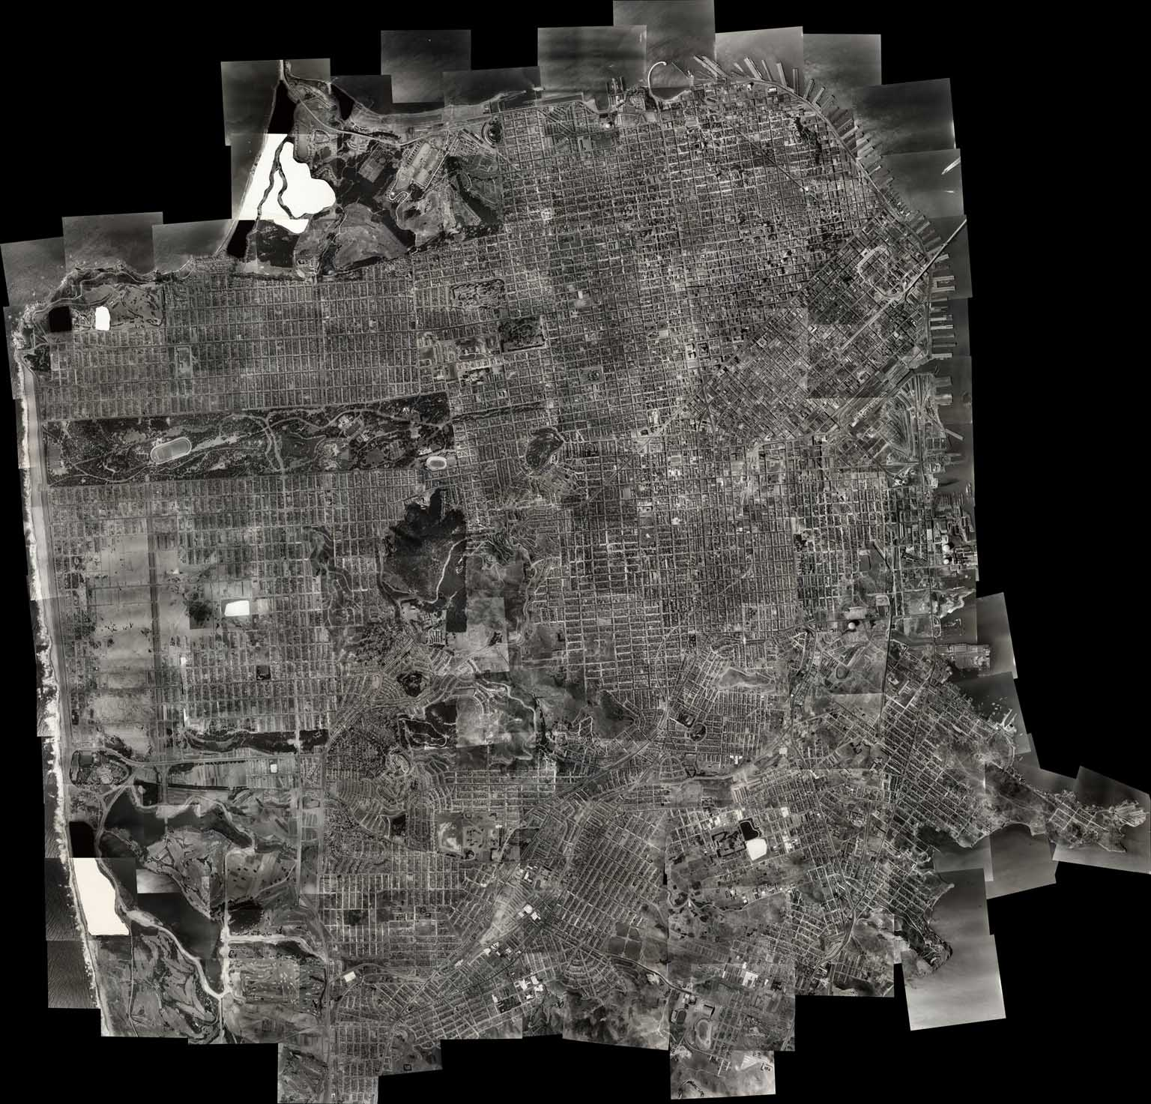
Harrison Ryker Arial 1938
Notes:
http://www.davidrumsey.com/luna/servlet/detail/RUMSEY~8~1~217045~5503226:-Index-Map-to--Location-of-Aerial-P?sort=Pub_List_No_InitialSort%2CPub_Date%2CPub_List_No%2CSeries_No&qvq=q:aerial%2B1938;sort:Pub_List_No_InitialSort%2CPub_Date%2CPub_List_No%2CSeries_No;lc:RUMSEY~8~1&mi=0&trs=165
Search for arial 1938 and Number after looking at the index

Slide 7
1940 Census
Searching:
http://www.archives.gov/research/census/1940/videos.html
Notes:
http://www.stevemorse.org/census/unified.html
http://1940census.archives.gov/
Search,
Block Index
Street names

Slide 8
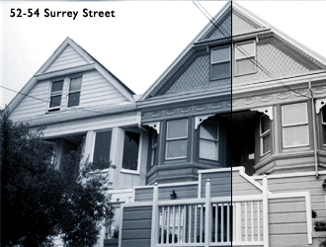
History Of Glen Park
http://www.sfaa.org/0112verplanck.html

Slide 9
Cal Atlas Arial Maps
http://atlas.ca.gov/imagerySearch.html

Slide 10
Topo Maps
http://www.klofas.com/topo/
Notes:
The Past: The Federal Government used your tax dollars to map, in detail, the entire United States. This gigantic undertaking was done by the United States Geological Survey (USGS). Every line on every topo map that the USGS produced was drawn in by hand, there were no computers when this project started. Check out the fascinating history of how topo maps are made here. Maps were previously printed and sold at cost, usually around three dollars, at any one of the Major Field Offices. The Present: Private companies now own digital copies of the maps. While you can still buy paper copies for around six dollars, digital copies are for sale for a lot more. The maps should be public domain because tax dollars were used to create the maps. The State of California struck up a deal with the federal government to freely store these maps on a server at UC Davis, and freely distrubute. The Future: Here you can download all of the topo maps of Calfornia for free. Due to diferences between the NAD27/WGS84 datums (what the topo maps are based on)and the State datum (what the "property line" of the state is based on), the southern edge of Oregon and the western edge of Nevada are also included. There are also a lot more than just topo maps on the California Saptial Information Library's webpage, including bathymetric maps, satellite images, highway plans, census data, geopolitical maps, and much more. There are also several interactive mapping programs on the CaSIL webpage, including DRG

Slide 11
Thanks !

